Slide 1
Minnesota Housing Fix Up Loan Program New Lender Training
June 20, 2017
Notes:
Hello! Welcome & introduce myself.

Slide 2
Agenda
Minnesota Housing
Fix Up
Eligibility
Process
Underwriting
Closing/Post-closing
Community Fix Up
Resources
Notes:
This are the items we’ll be covering today. Overall, we’ll be speaking about general programmatic information. As I’m sure you’re aware, we’re presented with unique situations frequently in this industry, which is why we make ourselves available to you for questions or concerns.
I’ll also be referencing the website a lot during this training. All of the information and forms that we discuss today are available on the Minnesota Housing website.

Slide 3
Mission
Housing is the foundation for success, so we collaborate with individuals, communities and partners to create, preserve and finance affordable housing.
Notes:
Starting out with a little more information about who Minnesota Housing is as an agency.

Slide 4
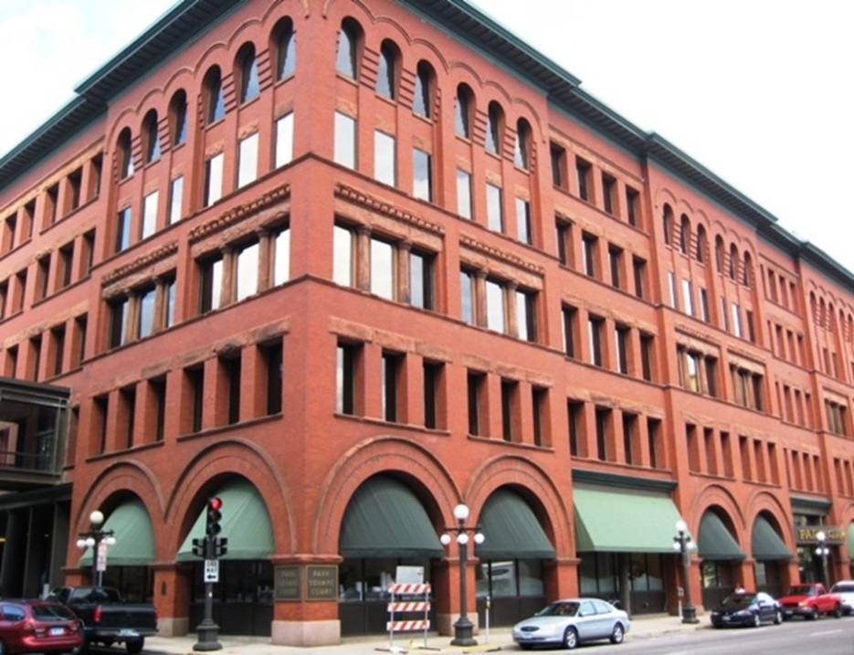
About Minnesota Housing
State’s housing finance agency
In 2016, invested $1.09 billion and served nearly 67,000 households
Single family lending products and multifamily financing

Slide 5
Fix Up Loan Program

Slide 6
Benefits
Enables and motivates
Self-supported
Wide variety of lender partners
Fills a lending gap
Notes:
Fix Up enables borrowers to afford repairs and updates, as well as motivates them to invest in existing housing stock. Self-supported: using agency resources and loan repayments
Lending gap: moderate income households

Slide 7
Fix Up Loan Types
Fix Up Loan Program
Unsecured Loan
Secured Loan
Unsecured Energy Loan*
Secured Energy/Accessibility Loan*
*No income limit

Slide 8
Comparison
Loan Type | Max Loan Amount | Max/Min Repayment Term | Min Credit Score | Interest Rate | Income Limit | Max LTV
Unsecured | $15,000 | 10 years/3 years | 680 | 6.99%* | $104,000 | n/a
Unsecured Energy | $15,000 | 10 years/3 years | 680 | 4.99% | n/a | n/a
Secured | $50,000 | 20 years/1 year | 620 | 5.99% | $104,000 | 110%
Secured Energy/ Accessibility | $15,000 | 20 years/1 year | 620 | 4.99% | n/a | 110%
*Rate reduced to 6.49% if borrower signs up for auto-draft payments at closing
Notes:
This chart is available (in more detail) on our website – document called Features and Programs Summary. Personally, I have it next to my phone so that I can use it as a quick reference guide when I get calls.
Distinctive features of the program = higher LTV, longer loan terms (up to 20 years), unsecured option
NOTE: reduced rate (6.99 to 6.49) if borrower enrolls in auto-draft payments, talk more about this later
*Note no income limit on energy/accessibility option

Slide 9
Improvements
ELIGIBLE
Personal property items such as appliances
Outbuildings, gazebos, pools, saunas, hot tubs
Garage space greater than 800 square feet per property
Basic and permanent residential repairs, remodeling and energy conservation
Basic garage
Accessibility improvements
Work that’s already started or completed
INELIGIBLE
Notes:
These are just a sample of the many types of improvements that can be done with a Fix Up loan. Borrowers can finance work that has been completed in the last 120 days. List can be found on our website, although that is not necessarily exhaustive.

Slide 10
Improvements
ELIGIBLE
Window replacement
Insulation
Air sealing
Kitchen and bathroom remodeling
Add a porch or deck
Siding, painting, roofing
Electrical, plumbing
Replace well, septic system
Sidewalk or driveway upgrades
Ramps
Stair lifts
ENERGY STAR furnace, air conditioner, water heater
Notes:
Sample of eligible improvements
• Window replacement, insulation
• Kitchen and bathroom remodeling
• Add a porch or deck
• Siding, painting, roofing
• Electrical, plumbing
• Replace well, septic system
• Sidewalk or driveway upgrades
• Garage, if property doesn’t have one
Incentive Rate ‐‐Secured Loans
Energy and Accessibility
• Energy Conservation: Energy Star rated
windows, furnace, central air conditioner,
water heater; insulation, and air sealing (See
Incentive Rate Energy Conservation & Accessibility on Forms page)
• Accessibility: Ramp, widening doorways and
hallways, grab bars, stair lifts, bathroom
fixture modifications
For more expansive projects, use other Fix Up loan options

Slide 11
Eligible Properties
ELIGIBLE
Single family home
Duplex, tri-plex, four-plex if homeowner occupies a unit
Townhome or condo
Manufactured homes permanently affixed to foundation with utilities in place and taxed as real property
Personal property
Mobile homes
Common areas in townhomes or condos
INELIGIBLE

Slide 12
Eligible Properties
ELIGIBLE
New construction at least 90 days old
Loan to “after-improved” value of 110%
Fee simple, C4D, Life Estate, CLT ownership
Trust Estate, reverse mortgage ownership
INELIGIBLE
Notes:
-on a new purchase, include a copy of the note/mortgage showing the payment and lien amount Reverse mortgage OK if the loan is unsecured and borrower enrolls in automatic payments. Tribal: unsecured only. Need home-site lease agreement.

Slide 13
Eligible Borrowers
48%
DTI
Guarantor
Credit Scores
Credit History
55%
620 Secured
680 Unsecured
18 months
Notes:
Monthly DTI may not exceed 48% unless there is a guarantor and 1.) The borrower’s monthly DTI does not exceed 55% and 2.) The combined monthly DTI for borrower and guarantor does not exceed 48%.
Credit history timeframe refers to foreclosure or bankruptcy.

Slide 14
Process
Applies for Fix Up loan with Minnesota Housing approved lender
Originates, underwrites, closes and funds the loan
Sells the loan to Minnesota Housing
Purchases the loan from the lender
BORROWER
LENDER
MN HOUSING

Slide 15
Your Role
Establish an internal process
Origination
Processing
Underwriting (develop standard guidelines)
Closing
Program does not require escrows or lender inspections
Notes:
Allowed to have overlays, but must be consistent.

Slide 16
Application
Dealer loans are ineligible
Complete all sections in full
Note borrower completed sections vs. lender completed sections
Be specific
Review certifications
Notes:
Do not save application to desktop or in a folder. Bookmark MN Housing website to ensure the application you’re using is current. Be specific and detailed in the application. Don’t skip sections, don’t generalize.
Review certifications with borrower so they understand their responsibilities.

Slide 17
Income
Qualifying (Underwriting) Income
Program Eligibility Income
48% (55%)
Borrower’s ability to repay loan
Document to the lender’s underwriting standards
vs.
$104,000
Income of all owner occupants
Only applicable to loans with income limits
Notes:
Use the Income Calculation Worksheet! This is not required, but highly recommended. SHOW YOUR WORK. *Guarantor income not counted in eligibility income.

Slide 18
Determining Value
Current Market Value
After-Improved Value
Determined with…
Property Tax Statement
Broker’s price opinion based on a competitive market analysis
Appraised value or sales price of new purchase
Other methods as approved by Minnesota Housing
Total of…
Current market value
1/2 cost of improvements
Notes:
*Use three comparables in a competitive market analysis

Slide 19
Determining Value
Determining Loans
Determining Value
Lien Type | Balance
Existing 1st Mortgage | $100,000
Existing 2nd Mortgage | $3,000
Proposed Fix Up Loan | $20,000
Total Liens | $123,000
Current Market Value | $110,000
½ cost of the proposed improvements | $10,000
“After-Improved” Value | $120,000
LTV = Loans ($123,000) divided by value ($120,000)
103%

Slide 20
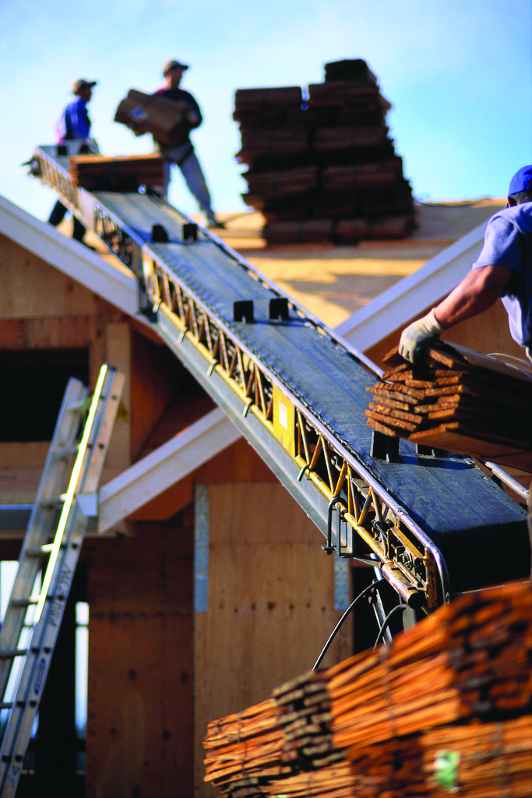
Demonstrating Ownership
Secured Loans:
Owner’s and Encumbrances Report
Unsecured Loans:
Property tax statement and
Copy of the deed
Notes:
Emphasize that with unsecured, we do need BOTH of these documents, it’s not either or

Slide 21
Documenting Improvements
Reference Allowable Improvement Guides
Contractor-completed labor estimate must be:
Written
Dated
Detailed
Homeowner-completed labor itemized estimate:
Detailed list of materials needed
Directly from a retailer
No labor costs included
Not allowed on Energy Incentive loans
Homeowner Labor Agreement
Notes:
Bids/estimates – should be on letterhead from a contractor, or at least attach a business card. Prefer to have contractor sign. Must be dated. Homeowner – cannot “take the homeowner’s word for it.” Cannot accept, for example, an excel spreadsheet.

Slide 22
Refinancing
Allowed
Not Allowed
Unsecured to secured
Incentive rate to secured
Secured to secured
Secured to unsecured
Secured to incentive rate
Notes:
If people come back and want/need additional repairs, refinance is possible. *Note: multiple Fix Up loans are OK, as long as the borrower qualifies, with some restrictions on balances. Refer to Procedural Manual if these situations arise.

Slide 23
Fees and Compensation
Secured Loans
Financed:
1% Orig
Doc Prep (up to $50)
Title Fees
BPO (up to $150)
Cash:
Credit Report Fee (up to $15)
Recording Fees
MRT*
Unsecured Loans
Financed:
Doc Prep (up to $50)
Cash:
Credit Report Fee (up to $15)
Compensation: $250
Compensation: $400
*Fix Up loans may be exempt from MRT (check with your county recorder)

Slide 24
Commitment System
Tracks intended use of funds and loan status
Lock rates
Accessed through website
Managed by Web Admin
Training
Process Guide
Webinars
Notes:
Hopefully, you have done the Commitment System training, which is offered on a monthly basis. If not, I would recommend that anyone using the system do this training.
When to lock: typically, when you have a signed credit application, general idea of projects, credit report & income docs

Slide 25
Closing: Process
Minnesota Housing documents (see website)
Lending partner documents
Mortgage
Notice of Sale and Transfer
Compliance documents (TRID, Right of Recession, etc.)
Determine first payment date
20-45 days from date of the note
Do not collect prepaid interest
Move loan to Funding Approved
Will subsequently be advanced to Purchase Approved

Slide 26
Closing: Signatures
Secured Loans:
All borrowers and/or guarantors must sign note and application
All property owners must sign mortgage
Unsecured Loans:
All borrowers and/or guarantors must sign application and note
Notes:
*Note: a separated spouse would also have to sign

Slide 27
Closing: Auto-Draft
Reduces interest rate on regular unsecured
Borrower to complete form at time of closing
Set up post-closing for all other loan types
Include voided blank check
Termination of auto-draft service
Notes:
On the unsecured Fix Up, this reduces the 6.99 rate to 6.49 *If the borrower decides to withdraw from auto-draft the rate will increase back to 6.99, or if three insufficient fund returns in a 12-month period, auto-draft will terminate and the rate will increase.

Slide 28
Closing: Servicer
Available on our website:
Reference Loan Servicing Information
Temporary Payment Coupon
After closing, borrower will receive welcome packet
Notes:
Explain this to the borrower – up until this point, they may not have realized the role AmeriNat plays in their loan.

Slide 29
Post-Closing
Record mortgage and assignment (if applicable)
Prepare Loan Transmittal
Originals to Servicer
Copies to Minnesota Housing
Retain copy of file

Slide 30
Quality Control
Post closing review
Adherence to program guidelines
Compliance with underwriting requirements
Indicators of fraud
Trends
Loans selected
New lender’s first three files
Sample of loans annually
Loans with early payment default
Notes:
Sample of loans annually = approximately 10%. If you have low volume, many, if not most of your loans may be audited.

Slide 31
Community Fix Up Program
Notes:
The Community Fix Up Loan Program is an add-on program for eligible Fix Up lending partners and provides affordable financing to support partnerships that target resources.

Slide 32
Benefits
Targets Fix Up loans to a specific community need
Reduced rate
Rate write-down option
Offering a value-added service

Slide 33
Example
St. Paul City Limits
Using HRA funds for discount rate write-downs
3% for households with incomes less than 60% AMI
4% for households with incomes less than 80% AMI
Community Partners
Value added services: home energy audits
Financing: matching loan programs

Slide 34
Resources

Slide 35
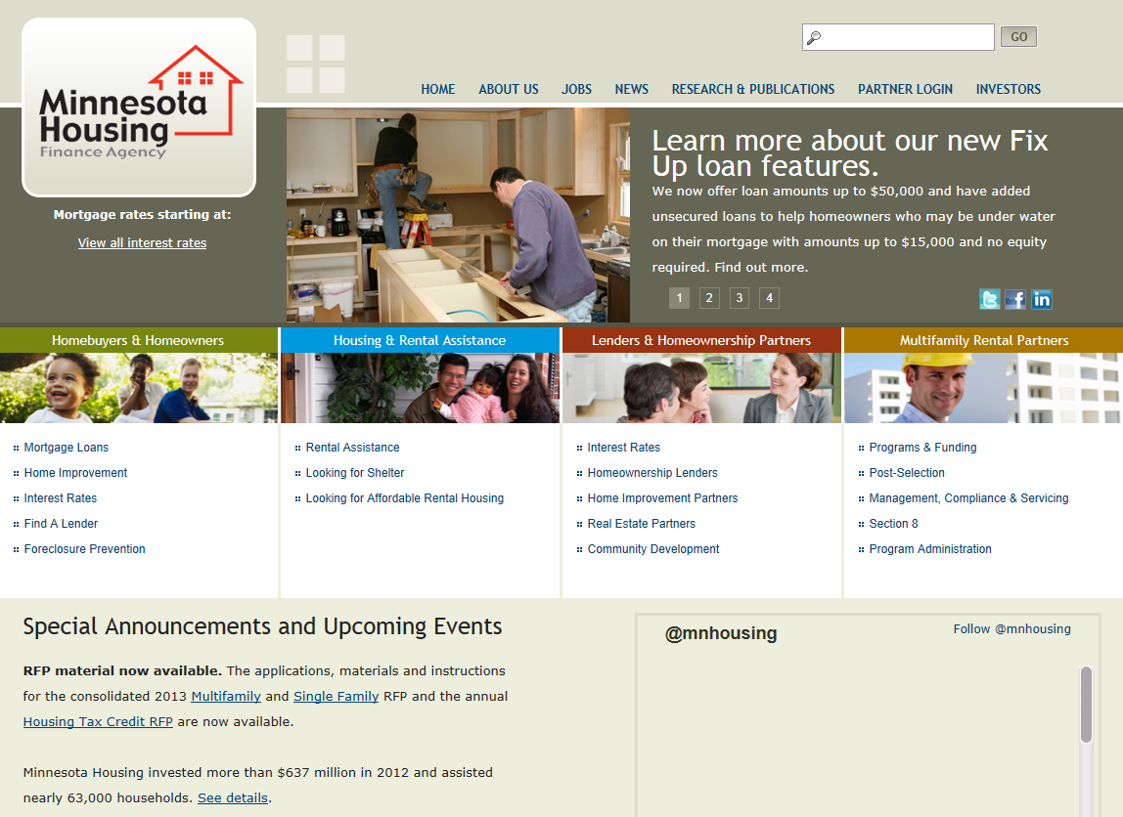
www.mnhousing.gov
Notes:
Here you can find the most current Minnesota Housing interest rates, program information, and guidelines. It also contains lists of our lender partners, who you can assist you in determining if your client may be eligible and how the approval process.
**If you have not yet done so, I would highly recommend going to the website and reading the Procedural Manual and taking a look at all of the other forms.

Slide 36
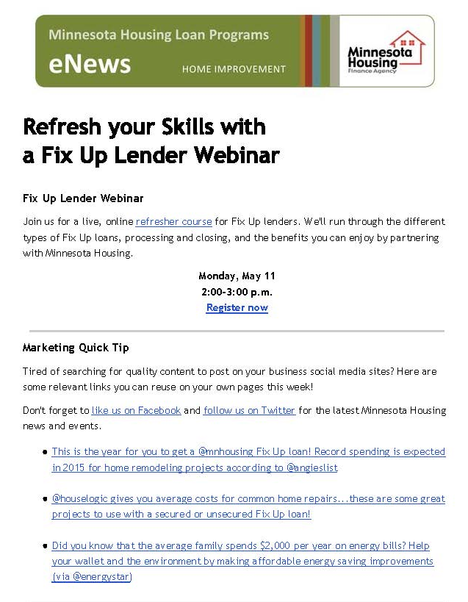
eNews
Don’t miss out on important news and events!
Notes:
This is how we communicate with our lender network as whole – program or form changes, events or trainings. We will not bombard you with e-mails!

Slide 37
Promotional Materials
Our free materials make promoting Minnesota Housing programs easy!
Visit the Marketing page to order.
Notes:
Want to help you promote the program.
Go to our website to order for FREE, or contact us.

Slide 38
Social Media
facebook.com/minnesotahousing
@mnhousing
linkedin.com/company/minnesota-housing-finance-agency
Notes:
Like us on Facebook. Follow us on Twitter and LinkedIn for program updates and news.

Slide 39
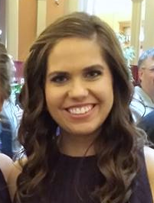
Contact Us!
SHANNON GERVING
651.296.3724
shannon.gerving@state.mn.us

