Slide 1

Performance Review Process Training for New Managers
by Amy John, HR Representative
Notes:
Thanks for attending our performance review training. We’ve scheduled an hour but it may take less time. Feel free to ask questions throughout or afterwards.

Slide 2
Agenda
Overview of Performance Review Process
Completing the Review in SuccessFactors
Performance Review Guidelines
Compensation Decision Guidelines

Slide 3
What is Performance Management?
Performance management is a process to:
Align individual goals with strategic goals, and division work plans
Identify and track individual performance
Evaluate performance
Identify training needs
Recognize and reward good performance
Identify and correct performance gaps
Notes:
Performance management as a whole helps us to…..

Slide 4
Performance Review System
Identifies, Assesses, and Improves Employee Performance
Creating Goals
Work towards achieving goals and objectives
Midyear Discussions
Annual Self Review
Manager Review
Performance Review Meeting with Manager
Notes:
Starts with creating goals in November. Work towards fulfilling those goals. Then have employee mid-year review in the Spring. Then the employee completes their self-review in the Fall, you view their self-review and complete your review, and then you have your in-person performance review meeting.

Slide 5
Organizational Competencies
Communications
Productivity and quality of work
Customer focus
Teamwork
Job Knowledge
Work management and continuous improvement
Decision making and problem solving
Adapting to change
Professionalism and workplace conduct
Notes:
The organizational task force created these 9 new competencies that all staff will be reviewed upon this year to replace being reviewed upon the technical competencies. The task force thought about what competencies could be applied to all employees, in a variety of different jobs.
Descriptions of these competencies are on the intranet and will also show up on your performance review.
For the job knowledge competency, your knowledge of your overall work and how you feel you perform the technical competencies listed in your job track should be referenced when rating yourself on this competency.
Those that are in managerial plan and manage others have 4 additional competencies that they are reviewed on.

Slide 6
Additional Organizational Competencies for Managers
Vision, leadership and motivation
Organizational management
Coaching and mentoring
Delegation
Organizational judgment
Notes:
Those that are in managerial plan and also manage others have 5 additional competencies that they are reviewed on.

Slide 7
Work Plan Overview
Notes:
As we discussed, before, your overall work plan still consists of your competencies and your goals. Your competencies are still 40% of your overall annual performance review rating and goals are still 60% of your overall performance review rating.
Later on in November, we will offer optional presentations to staff with tips and tools regarding how to create your goals for the next performance review cycle. But as you know from the goals that you have already created this year, your goals basically outline the most important areas of your job, and are individually weighted and rated in your review.

Slide 8
Format For Goals
Employees should create 4-5 broad goals
Employees should create a few expected outcomes, or sub-goals to support the broad goal.
  Include due date/frequency in the wording of the expected outcome if possible
  Don’t create more than 10 expected outcomes
Notes:
Recommend creating 4-5 goals. Expected outcomes can be helpful. SF requires them. Others do not. Check with mgr on their preferences.
For rating your goals, you will be able to enter into the system the percentage of the goal that was accomplished and add comments regarding why you provided yourself with the rating that you did.
You can also say that a goal was cancelled if you were unable to complete it due to circumstances beyond your control.

Slide 9
Format For Goals
  The timeframe for goals should be 9/1/2016 – 8/30/2017 for those in AFSCME, MAPE or MMA.
  The timeframe for goals should be 11/1/2016 – 10/31/2017 for those in Managerial Plan or Commissioner’s Plan.
Notes:
Recommend creating 4-5 goals. Expected outcomes can be helpful. SF requires them. Others do not. Check with mgr on their preferences.
For rating your goals, you will be able to enter into the system the percentage of the goal that was accomplished and add comments regarding why you provided yourself with the rating that you did.
You can also say that a goal was cancelled if you were unable to complete it due to circumstances beyond your control.

Slide 10
Mid-Year Discussions
Midyear Informal Performance Discussion occurs in the Spring. No forms are completed.
Key Points:
What is going well
What is not going well
What training/development is needed
Notes:
So now that we have gone over the changes we have made to the performance review process, and talked about the competencies and goals that are a part of your performance review, let’s talk a little about mid-year reviews. All employees just had these in the Spring. They are just an informal check-in between you and your manager regarding how things are going with your work. No forms are completed and nothing is turned into HR. It’s just a good opportunity each year to check in, see if any goals need to be changed or updated, talk about training opportunities you’d like to take, and talk about your work.

Slide 11
Annual Performance Review
Go into SuccessFactors and review your employees’ competencies, goals and self-reviews
Rate your employee on each individual goal and competency
When you save your review, it will calculate an overall performance review rating
Notes:
Then of course at this time each year we have our annual performance reviews for all staff.
It can be hard to remember everything that employees have accomplished over the past year. Take a look at your past notes. Look back to recall the various projects that have occurred throughout the year.
Go into SF. View employee’s self-review. Review them in the system.

Slide 12
Best Practices
Review notes you have made throughout the year to include in review
Review comments can be short; just need enough specific information to support your rating
Use specific examples of work when possible
Focus comments on facts. Give honest, fair assessment of performance
Use review to comment on performance issues employee has resolved or needs to address, as an overall rating of AE or higher will negate prior performance issues
Notes:
Then of course at this time each year we have our annual performance reviews for all staff.
It can be hard to remember everything that employees have accomplished over the past year. Take a look at your past notes. Look back to recall the various projects that have occurred throughout the year.
Go into SF. View employee’s self-review. Review them in the system.

Slide 13
Performance Review Ratings
Requires Improvement (RI)
  Performance is below expectations and is not acceptable
  Work is of low quality, incomplete, untimely and requires corrective action
Achieves Expectations (AE)
  Performance meets competency, reliability, quality, quantity, and timeliness standards
  Performance may exceed expectations in some areas, but on balance, it meets expectations
  Common rating for fully competent employee

Slide 14
Performance Review Ratings
Surpasses Expectations (SE)
  Performance consistently surpasses expectations of reliability, quality, quantity, and timeliness
  Performance demonstrates task excellence and commitment to agency goals
  Employee willingly exerts extra effort when needed and actively seeks out ways to improve skills, knowledge, and competencies
Exceptional Performer (EP)
  Performance consistently exceeds expectations despite unforeseen circumstances
  Employee anticipates and prevents problems and serves as role model
  Performance is clearly unique and rarely attained

Slide 15
Performance Review
Audit Criteria
  Review will also be reviewed by your manager and Human Resources.
  HR and Commissioner will audit reviews to ensure:
  Ratings other than AE are documented with specifics.
  Ratings where manager disagrees with employee need to be documented with specifics.
  Overall performance summary is written at end of review.
  Overall ratings of RI will result in additional intervention to correct performance gaps.
Notes:
-Goes to Mgrs mgr – 2nd level mgr – for feedback and consistency
Goes to HR to ensure mgr entered comments to support rating
Commissioner reviews around 10% of reviews to stay informed, ensure ratings consistency
We will send review back if guidelines aren’t followed.
We are also asking for employees this year to fill out the Employee Comments section at the very end of the review in order to talk to your manager about you feel your performance was as a whole during the past year. So if you could encourage your employees to do this as well, that would be helpful.

Slide 16
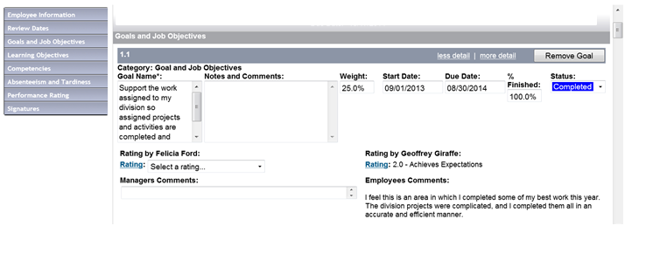
Performance Review Process in SuccessFactors
Notes:
Performance review for Brad Pitt is in Jennifer Anniston’s account. Jennifer reports to Courtney Cox.

Slide 17
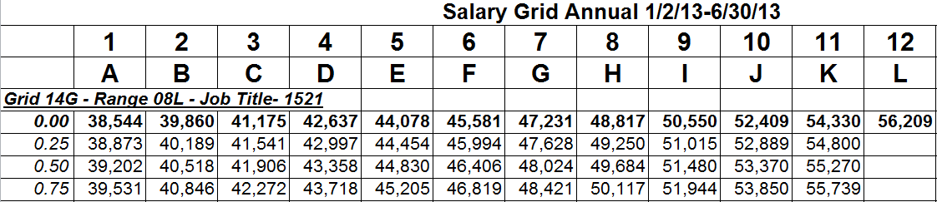
Compensation
Each job classification has a salary range. Salary ranges are further broken down into steps on a salary grid.
Example of Salary Grid:
Notes:
Each job classification has a salary range. Salary ranges are further broken down into steps on a salary grid. This is an example salary grid. The minimum you can be paid is step one, the maximum is step 12.
All of you just received a 3% cost of living increase on July 1 as that was listed in your union contract or plan. Those COLAs are listed in the union contract or plans most years. This increase altered the salary grid so that if you were a step 7, you’re still a step 7, it’s just that the rate corresponding with step 7 has changed.
During our annual performance reviews, you have another chance to receive a salary increase.

Slide 18
Compensation
AFSCME employees receive a one step increase if above RI rating.
MAPE and MMA increases based upon overall performance rating:
EP SE AE RI
Steps Steps Steps No increase
2.0 1.75 1.50
1.75 1.50 1.25
1.00
Notes:
Employees whose salaries equal or exceed the maximum of their salary range will not be eligible for a salary increase, regardless of performance. Still get COLA in July.
Go back to grid and explain a one step increase.
If no increase will be given to an employee due to performance issues, the union contracts require that written notice be given to the employee regarding why they are not receiving an increase.

Slide 19
Compensation
New employees’ increases pro-rated based on hire dates:
Hire Date: Review Amount Date Given
Oct – Dec 2016 Full 100% 10/18/17
Jan – April 2017 Full 75% 10/18/17
May – July 2017 Informal .75 Step Probation end, retro to Oct
Aug – Sept 2017 Informal .25 Step Probation end, retro to Oct
Notes:
We will send employee an email at probation end to let them know about the increase and what the actual retro amt is.

Slide 20
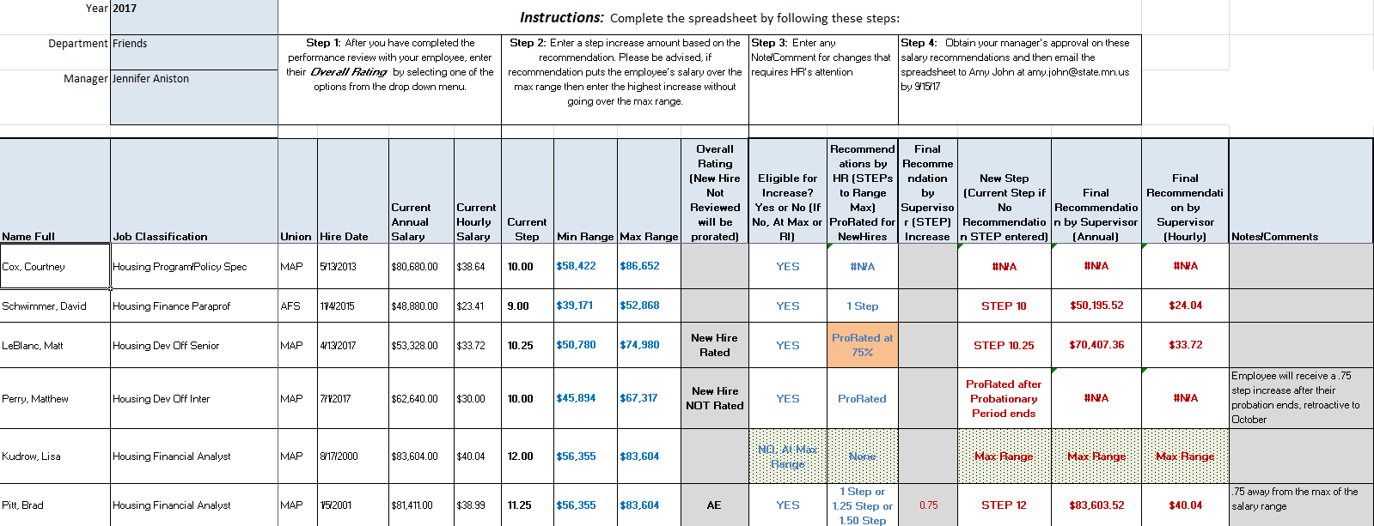
Compensation
Refer to the Salary Increase Recommendations by Department spreadsheet once your draft review is complete.
Notes:
We will send you this spreadsheet before 8/11.
Make sure you show them how salary changes once enter it in.
Tell them these are their step increase options; no other options.
For new employees, you will choose the new hire rated option for employees that were hired between Jan – April receiving the 75% proration option. Then for whatever step increase amount you entered into the final recommendation by supervisor column, the spreadsheet will automatically calculate it at 75%.
For employees that were hired from May – now and are receiving an increase after their probation, choose the new hire not rated option. Then don’t list a step increase amount into the final recommendation by supervisor column, as they will automatically receive either a .75 step or a .25 step increase once they pass probation, based on their hire date.
Tell them to email the spreadsheet back to you once its approved and CC their manager.

Slide 21
Performance Review
In-Person Meeting
  You can send your employees their reviews in SuccessFactors prior to the in-person meeting or you can have that be the first time they see it.
Have a meaningful discussion on:
  What went well
  What could have been improved
  Discuss developmental/training needs
  Review all items rated on performance review
  Advise employee of new salary
Notes:
For your in-person meeting with your employee, you will want to print out a copy of their review from SuccessFactors and go over the review in detail with them. But also make sure that you have a meaningful discussion on their performance from the past year on what went well, what could’ve been improved, and talk about how they feel about their performance. It’s great to touch base about any training opps they’d like to take in the future. And also advise your employee of what their new salary is going to be as a result of their review.

Slide 22
Employee Performance
Review Timeframe
7/31 – 8/11
8/14 – 9/1
9/5 – 9/15
9/18 – 9/22
9/25 – 10/13
10/18 PP; 11/10 PD
10/16 – 11/17
Employees complete self-reviews
Managers complete reviews and salary recs
2nd Level managers review and provide feedback
HR and Commissioner audit reviews
Managers finalize reviews; have in-person meetings Salary increases effective
New goals developed for upcoming year

Slide 23
For More Information
Please visit our Performance Management page on the intranet for:
  The Performance Review Training Guide for Managers
  Completing Employee Reviews in SuccessFactors video
  Job Tracks
  Salary Grids
Contact Amy John, HR Representative, at amy.john@state.mn.us or 651-215-5976, if you have any questions
Notes:
New videos are really helpful to refresh your memory on how to go about things in SuccessFactors.
Page lists the training guide, which has detailed information on the entire performance management process, more detailed information regarding everything we’ve gone over today, and screenshots of how to complete your performance review in SuccessFactors.
Total Time – about 37 mins

