Slide 1

Homeownership Investment Grants
Laurie Zabel | Business Relationship Manager

Slide 2
This Presentation is Being Recorded
“Minnesota Housing does not consent to the collection or use of its data by programs or systems that utilize artificial intelligence or large language models. If meeting attendees wish to have the meeting transcribed, please let the meeting organizer know and Minnesota Housing staff will provide a Teams transcription. If Teams transcription is used, any portion of the transcript containing public data under the Minnesota Government Data Practices Act must be provided to the person requesting the data."

Slide 3
Questions
All questions asked in this presentation will be recorded and answered in the FAQ. Please submit all RFP questions in writing to the chat. All other questions please submit to hig.mhfa@state.mn.us.
The FAQ will be posted on the Community Initiatives Homepage. Community Initiatives Homepage Link

Slide 4
Agenda
Intro to the Program
Eligibility
Walk Through the RFP
Scoring & Selections
Application Deadline/Timeline
Question Submission
Recap

Slide 5

Introduction to the Program
The Homeownership Investment Grants Program was created in 2023 by a one-time state appropriation.
This appropriation is intended to provide funding to Minnesota-based, non-profit, tax exempt, US Department of Treasury certified Community Development Financial Institutions (CDFIs).
This program offers up to $37 million in one-time funding for grants to eligible CDFIs.
Organizations applying for a grant must include a plan to create new affordable home ownership and home preservation opportunities for targeted areas (areas defined by Administrator).

Slide 6
Eligibility
Eligible Organizations:
Nonprofit organizations who meet all the following:
Qualify for tax exempt status under United States Code, Title 26, section 501 (c)(3)
Have primary operations located in Minnesota
Be certified as a community development financial institution by the United States Department of the Treasury and
Provide affordable housing lending or financing programs

Slide 7
Eligibility
Eligible Projects:
Eligible organizations may apply for Homeownership Investment Grants for affordable owner-occupied housing projects for the purposes of:
Housing development to increase the supply of affordable owner- occupied homes,
Financing programs for affordable owner-occupied new home construction.
Acquisition, rehabilitation, and resale of affordable owner-occupied homes or homes to be converted to owner-occupied homes.
Establishing revolving loan accounts at community development financial institutions.

Slide 8
Funding under this program will prioritize proposals that:
Will create impact and result in regional or statewide coverage and/or in underserved communities, including rural, Tribal communities and BIPOC Communities
Will create maximum impact on affordable homeownership supply, through efficiencies of scale and delivery, leverage, provision of low-cost capital, and/or revolving funds to leverage state investment.
Demonstrate experience in financing affordable homeownership through loans or grants to individuals and/or nonprofit organizations. Proposals demonstrating significant experience with direct lending, as well as lending in an intermediary role, will be prioritized.
Include outreach and service to BIPOC and underserved communities in the service area proposed and a plan to engage nonprofit homeownership partners who do outreach and service to BIPOC and underserved communities .
Demonstration of reaching low-and-moderate income households to achieving affordable homeownership.
Support the development and/or rehabilitation of owner-occupied housing in a range of communities so that low- and moderate-income Minnesotans have greater choice in where they are able to buy a home.
Demonstration of capacity and feasibility of the financing program(s) proposed.

Slide 9
Where to find the RFP Materials
www.mnhousing.gov
Menu in the right-hand corner
Homeownership
At the bottom of the Homeownership Menu is Community Initiatives
RFP is located on the Community Initiatives homepage

Slide 10
RFP Walk Through:
Application Checklist
One Page Narrative Outlining the Proposed Program
Application and Signature Page
Application Workbook
Pre-Award Risk Assessment Form and Accompanying Documents
Budget Workbook
Community Development Financial Institution Treasury Certification
501(c)(3) Certification

Slide 11
RFP Walk Through:
One Page Narrative
Explain the program or program concept in detail
High level overview
Please complete a narrative for each activity

Slide 12
RFP Walk Through:
Application and Signature Page
Name of Applicant
Eligibility status
Amount of funding
Geographic area serving
Signature

Slide 13
RFP Walk Through:
Application and Budget Workbook
Tabs at the bottom of the Excel Workbook for each activity.
Select the correct tab for your activity and answer each of the questions fully. If you feel that the question does not apply, please describe why in your response.
Complete the Budget Workbook

Slide 14
RFP Walk Through:
Pre-Award Risk Assessment
Pre-Award Risk Assessment Form and accompanying documents detailed in the form
  Risk Assessment Form—Nonprofit Organizations
  Accompanying Documentation:
    Financial Documents related to the applicant organization and detailed on the Risk Assessment Form (outlined on following slide)
      Internal Controls Certification—Nonprofits Organizations, if applicable
    Evidence of good standing with the Minnesota Secretary of State
    Certification of no convictions of felony financial crimes by a principal, along with a list of principals being certified.

Slide 15
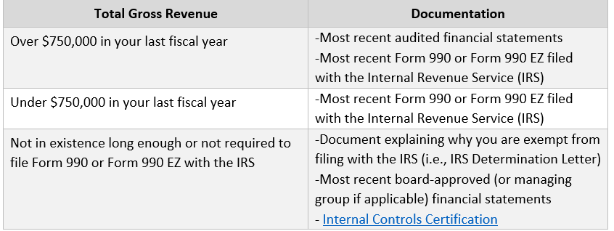
RFP Walk Through:
Pre-Award Risk Assessment Additional Documents

Slide 16
RFP Walk Through:
Additional Required Documents
  Community Development Financial Institution Treasury Certification
  501 (c) (3) Certification (990 or IRS Print off)

Slide 17
Scoring:
Overall Proposal and Strategy to Maximize Impact
Organizational Capacity
Equity/ Diversity
Populations and Homebuyers to be Served
Targeted Service Area
Budget
3 points each for a total of 18 points. Additional scoring information is found in the RFP instructions.

Slide 18
Scoring:
Reviewed and Scored by Staff
Reviewed and Prioritized by Selections Committee
Reviewed and Voted on by Minnesota Housing Board of Directors

Slide 19
Selections:
If an organization is selected, they will be notified within 10 working days of Board approval.
The selected applicants will be invited to launch meetings.

Slide 20
Application Deadline
Submit * No other staff are authorized to respond to questions from potential applicants related to this RFP. All questions and answers will be posted to Minnesota Housing’s website
Submit via leapfile by noon on March 12th. There are no exceptions. Files cannot be submitted any other way.
Laurie.Zabel@state.mn.us is the submission email in the secure file exchange.
Incomplete applications will result in your application not being considered.
Minnesota Housing does not inform applicants when applications are incomplete.

Slide 21
RFP Contact:
Submit * No other staff are authorized to respond to questions from potential applicants related to this RFP. All questions and answers will be posted to Minnesota Housing’s website
  Questions can be directed to the designated point of contact:
  Laurie Zabel, Business Relations Manager
  651-227-2003
  Hig.mhfa@state.mn.us
No other staff are authorized to respond to questions from potential applicants related to this RFP. All questions and answers will be posted to Minnesota Housing’s website.

Slide 22

Questions- Submit all questions in writing to hig.mhfa@state.mn.us.
All
All questions will be recorded and answered. They will be made available in the FAQ that will be posted here: community-initiatives-programs.

Slide 23
Recap
All of the presented information can be found within the RFP (with the exception of the Q&A)
A recording of this presentation will be made available on the website and Q&A will be posted as soon as possible
The RFP closes March 12th at noon and everything must be submitted in leapfile. (See Secure Upload Instructions under the RFP on website)
Please submit any questions by February 25th

Slide 24
Thank You!
Laurie Zabel
Hig.mhfa@state.mn.us

